Slide 1
SBA Loans Update and PPP Loan Forgiveness Information and Application Process

Slide 2
Today we’ll cover:
EIDL and PPP Loan Update information
PPP Loan Forgiveness Forms 3508, 3508EZ, 3508S
Changes from the PPP Flexibility Act
Definitions of Payroll Use, Costs, Covered Period & Time Frame
Definitions of Covered Period
Form 3508S Details - Form 3508EZ Details
Self Employed Individuals/Sole Proprietors
Lender Process for Loan Forgiveness & Safe Harbors
Documents needed to prove loan eligibility and forgiveness
Deduction of EIDL Advance from Loan Forgiveness
Representations, Certifications, Audits, Appeals
Step by Step Examples of the Loan Forgiveness Applications

Slide 3
SBA Economic Injury Disaster Loan (EIDL) Update:
EIDL Funds are still available.
Apply here - https://covid19relief.sba.gov/#/
EIDL Advance – The EIDL advances are no longer available. For those who did receive EIDL Advances, remember that they will reduce PPP loan forgiveness if you received both the EIDL and the PPP loans.
Customer Service Center at 1-800-659-2955. To get the status of your EIDL loan, Call the 800 number and ask for a Tier 2 person.
To ask for EIDL reconsideration email to pdcrecons@sba.gov. You may be required to find and complete SBA form 3501. Partners must complete Form 4506-T (request for Transcript of Tax Return).

Slide 4
As of today, the PPP Loan program is no longer accepting new applications. In addition, the ability to get a 2nd PPP loan or renegotiate/increase your existing PPP loan is not available.
PPP Loan Data as of the end of PPP Loan program for new applicants as of 8-10-20:
Loans approved nationwide 5,212,128, Dollars $525,012,201,124, # of Lenders 5,460.
WA – Loans 107,287, Dollars $12,399,188,608.
86% of all PPP loans are under $150,000 and 68% of all PPP loans are under $50,000

Slide 5
The information provided in this presentation is relevant as of 12-08-20. Neither the presenter nor the Washington Small Business Development Centers are the final authority on this material. The information is subject to change at any time with new legislation and/or additional rules from the Treasury and/or the SBA.
On October 9th the SBA and US Treasury announced a new more simplified form for PPP borrowers/loans $50,000 or less.
This allows the PPP borrower $50,000 or less to waive the FTE requirement and the 25% reduction in staff wages to earn full loan forgiveness.
Certain Documentation to support the correct use of the PPP funds has to be submitted with the 3508S form.
Those with combined debts over $2 million, based on affiliated ownership, cannot use this form.

Slide 6
Steps to Applying for Loan Forgiveness:
Contact your PPP Lender and complete the correct form
Compile documentation – details in a later slide
Submit the forgiveness form and documentation to your lender. Some lenders are waiting until January to accept loan forgiveness applications.
Continue to communicate with your lender through the process.
Loan Forgiveness applications can be submitted when the borrower has 1) used all of the funds, 2) documented use of the loan proceeds is compiled, 3) lender is ready to accept the applications.

Slide 7
Which Form To Use?
3508S – One Page plus documentation for PPP loans of $50,000 and less (and no affiliation).
3508EZ – Two Pages plus documentation for PPP loans of more than $50,000 and you meet one of three criteria. Works for owner operated small businesses with PPP loans over $50,000.
3508 Long Form – Four Pages plus two pages in the instructions. Can be used for any PPP loan but works best for larger businesses with more detailed PPP situations or meeting one of the Safe Harbors.

Slide 8
The PPP Flexibility Act effective 6/5:
The Covered Period can be 8 Weeks or 24 weeks for borrowers who were funded prior to June 5th. The Covered Period is 24 weeks for borrowers who were funded after June 5th.
If the borrower does not have full loan forgiveness, the remaining amount will be a loan at 1% for 2 years for loans funded prior to June 5th . Loan term is 5 years for loans funded after June 5th.

Slide 9
The Loan Forgiveness Application Definitions/Details for All Forms:
Payroll costs are: all cash contribution including salary, wages, commission, cash tips, vacation pay, hazard pay, bonuses and parental, family, medical or sick leave & severance pay and employers payroll costs for health insurance, retirement plans and local, state taxes.
Loan forgiveness to be applied for within 10 months after the last day of the covered period or converts to a loan.
Payments on any remaining loan portion start 10 months after the end of the Covered Period.
Expenses that are forgiven may not be allowable business deductions for year end tax reporting.
Cost not eligible are: salaries in excess of $100K cash compensation, employees outside the US, sick or family leave under the Families First Act and Independent Contractors.

Slide 10
For all Loan Forgiveness Applications - PPP Covered Periods:
Covered Period defines - loan eligibility, use of funds and forgiveness requirements. This is determined and finalized at time of loan forgiveness.
You can only choose a covered period of 8 weeks or 24 weeks
Some costs incurred before the Covered Period (8 or 24 weeks) and paid during the Covered Period and some costs incurred during the Covered Period and paid afterwards can qualify for forgiveness.
Alternate Payroll Covered Period – May allow the Covered Period to start on the first day of the normal pay period rather than on disbursement of the funds (for payroll only).
Do not check the $2 Million Box unless you received a PPP for that amount or more. All borrowers with loans over $2 million are now being asked to complete a Loan Necessity Questionnaire.

Slide 11
Form 3508S Short Form:
Used for PPP Loans $50,000 and under
Waives the FTE (Full Time Equivalent) requirement
Waives the employee wage reduction of limit of 25%
Cannot have other Affiliated debt of more that $2 million.
Requires Documentation showing basis and proof of payments to be submitted with the 3508S

Slide 12
The PPP Loan Forgiveness Application 3508EZ Form:
Eligibility Criteria to use the EZ Loan Forgiveness Form:
Are you self-employed and have no employees; OR
You did not reduce the salaries or wages of their employees by more than 25%, and did not reduce the number or hours of their employees; OR
You experienced reductions in business activity as a result of health directives related to COVID-19 and did not reduce the salaries or wages of their employees by more than 25%.

Slide 13
Borrowers submitting Form EZ must certify either/or:
That you did not reduce the number of employees or the average paid hours between January 1 and the end of the Covered Period – other than documented reductions due to inability to rehire or find qualified employees.
That you were unable to operate between February 15th and the end of the covered period at the same level of business activity as before February 15th due to COVID-19 related compliance.
All records relating to the loan must be maintained for six years after loan forgiveness or the loan is paid in full and you must permit inspection of those documents on request.

Slide 14
Self Employed Individuals/Sole Proprietors:
Are eligible to use the 3508S or the 3508EZ Loan Forgiveness Application if you meet certain conditions.
Original PPP loan amount is related to payroll costs at 8/52 of line 31 of the individual’s 2019 Schedule C if you use the 8-week Covered Period. 2.5 months of 2019 compensation if you use the 24-week Covered Period.
Loan forgiveness is based on use of the funds provided – at least 60% for payroll and no more than 40% for rent, utilities and mortgage interest.
Amounts paid to owners do not exceed $15,385 per individual for those choosing the 8-week Covered Period and $20,833 for those choosing the 24-week Covered Period.

Slide 16
Loan Forgiveness (FTE Safe Harbor) Criteria Form 3508:
The new PPP Flexibility Act has substantiality increased the flexibility in eligibility for loan forgiveness. Three choices/criteria to establish FTE Reduction Calculation – Choose one:
1) You had no reduction in employees or average paid hours.
2) Safe Harbor #1 – Unable to operate between February 15th and the end of your Covered Period at the same level of business activity as before February 15th due to COVID-19 Compliance.
3) Safe Harbor #2 – If you satisfy the FTE requirements as shown on the Worksheet for Schedule A (Tables 1 & 2, pages 4 & 5 in the instructions) of the long form.

Slide 19
Payroll Proof of Payment (as much of this as exists):
Bank account statements,
3rd party payroll records,
Tax forms such as 941,
Copies of funds transfers, ACH, checks, etc.
State wage reporting documents for unemployment and L&I,
For the employer portions of: health insurance, retirement plans and state/local taxes – payment receipts and cancelled checks or account statements.

Slide 24
Representation, Certifications, Audits, Appeals:
All of the PPP loan forgiveness applications require representations and certification with signature to be submitted – The borrower must certify that they know and understand the rules of the PPP including eligibility, use of proceeds, loan forgiveness amounts.
The SBA may review PPP loans and Loan Forgiveness Applications as it deems appropriate and at any time.
Lenders are required to confirm the calculations on the loan forgiveness application.
The SBA has established rules and timelines for appeals for any PPP borrower who is determined ineligible for the PPP or reduced loan forgiveness.

Slide 25
Additional Information and Details:
Additional detail on “eligible owner compensation” is available in SBA FAQ dated 8/11/20 pages 5 & 6. We can provide this on request.
If a borrower applies for PPP loan forgiveness before the end of the Covered Period (8 or 24 weeks) and annual salary or wages were reduced by more than 25%, the borrower accounts for the reduction thru full covered period.
If only a portion of the PPP loan is forgiven or the loan forgiveness application is denied, loan payments are deferred until the SBA remits the loan forgiveness amount and notice to the lender and the borrower is notified.
We have additional information if a PPP borrower is being sold.

Slide 26
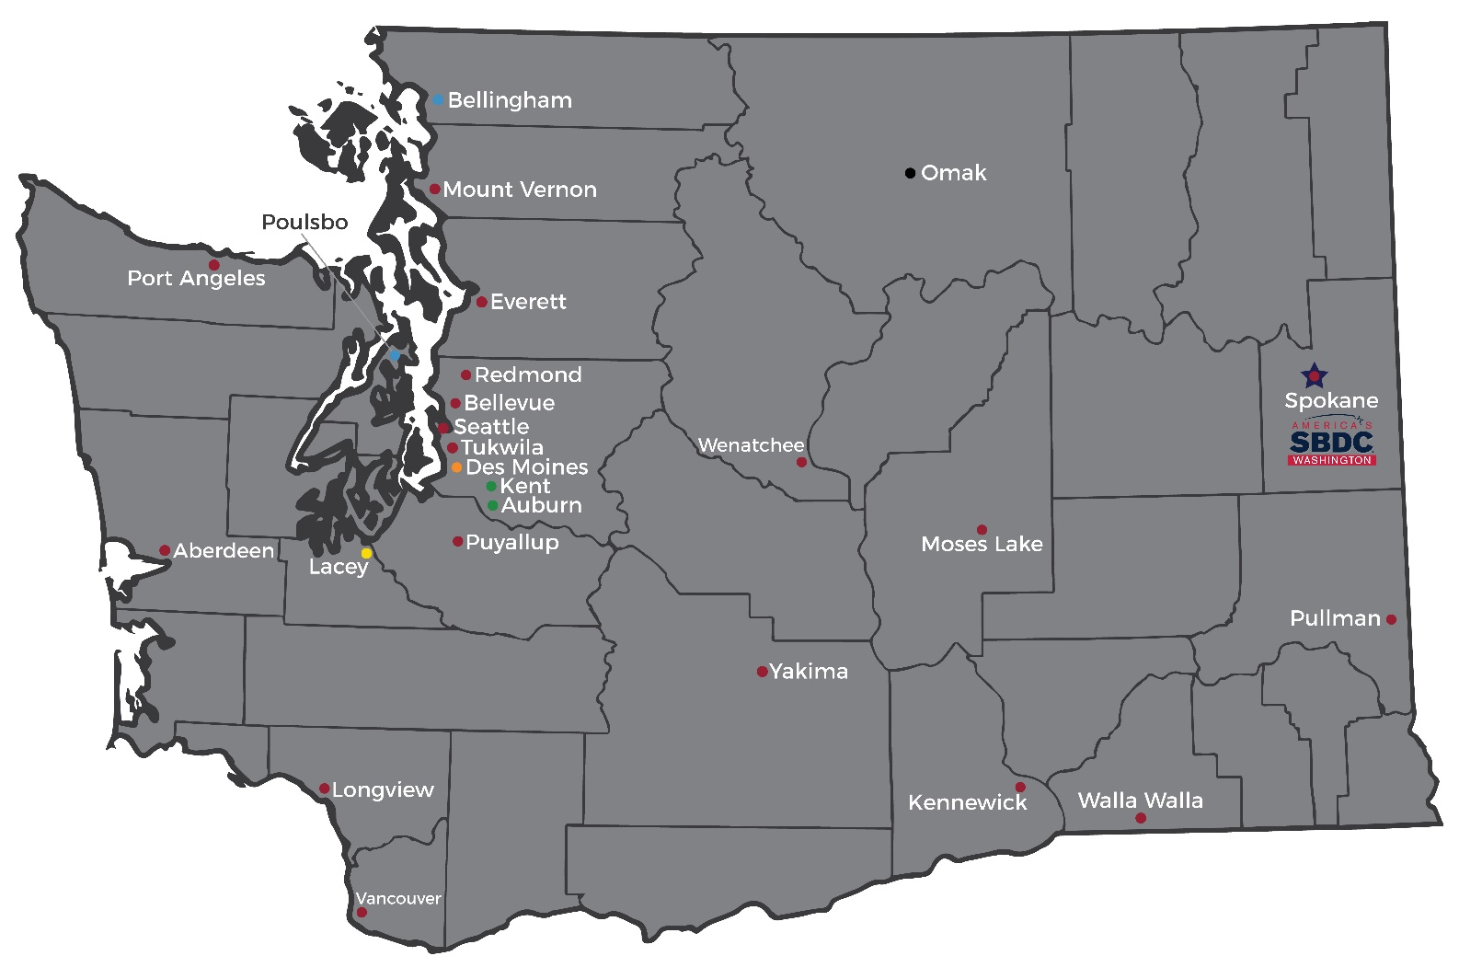
Find the Nearest Advisor: https://wsbdc.org/contact-an-advisor/ washington@wsbdc.org or 833-4WA-SBDC

Slide 28
Paycheck Protection Program
Loan Forgiveness Application Examples
Updated as of December 8th, 2020

Slide 29
Covered Period vs. Alternate Covered Period
Covered Period: is either (1) the 24-week (168-day) period beginning on the PPP Loan Disbursement Date, or (2) if the borrower received its loan before June 5, 2020, the borrower may elect to use an eight-week (56 day) covered period.
For example: if the borrower is using a 24-week covered period and received its PPP loan proceeds on Monday, April 20, the first day of the covered period is April 20 and the last day is Sunday, October 4.
In no event may the covered period extend beyond December 31, 2020.
Alternative Payroll Covered Period: For administrative convenience, Borrowers with a biweekly (or more frequent) payroll schedule may elect to calculate eligible payroll costs using the 24-week (168-day) period (or for loans received before June 5, 2020 at the election of the borrower, the eight-week (56-day) period) that begins on the first day of their first pay period following their PPP Loan Disbursement Date.
For example: if the Borrower is using a 24-week Alternative Payroll Covered Period and received its PPP loan proceeds on Monday, April 20, and the first day of its first pay period following its PPP loan disbursement is Sunday, April 26, the first day of the Alternative Payroll Covered Period is April 26 and the last day of the Alternative Payroll Covered Period is Saturday, October 10.
Borrowers that elect to use the Alternative Payroll Covered Period must apply the Alternative Payroll Covered Period wherever there is a reference in this application to “the Covered Period or the Alternative Payroll Covered Period.” However, Borrowers must apply the Covered Period (not the Alternative Payroll Covered Period) wherever there is a reference in this application to “the Covered Period” only.
In no event may the Alternative Payroll Covered Period extend beyond December 31, 2020.

Slide 30
Example 1 -
Form 3508S
Assumptions:
Sole Proprietorship with two employees
$50,000 PPP Loan
$3,000 EIDL Advance

Slide 31
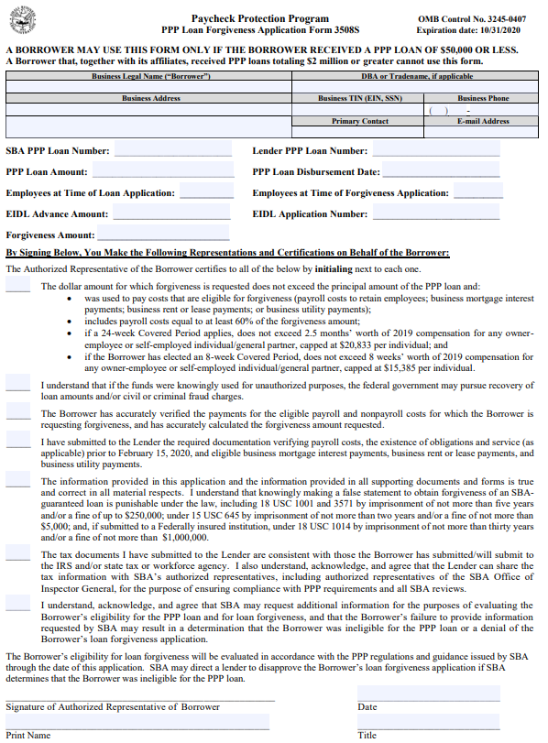
PPP Loan Forgiveness Application Form 3508S Page 1

Slide 32
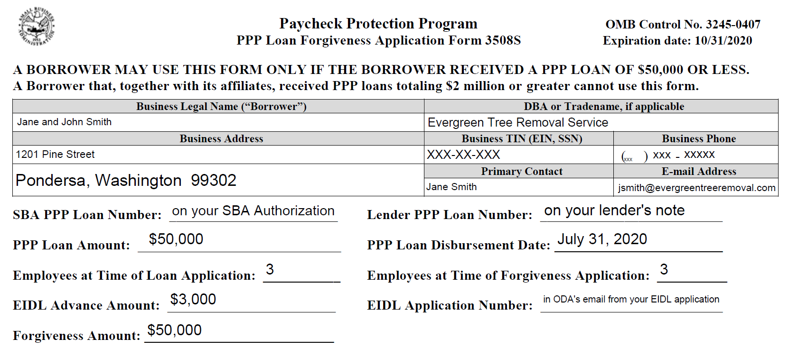
PPP Loan Forgiveness Application Form 3508S - Page 1

Slide 33
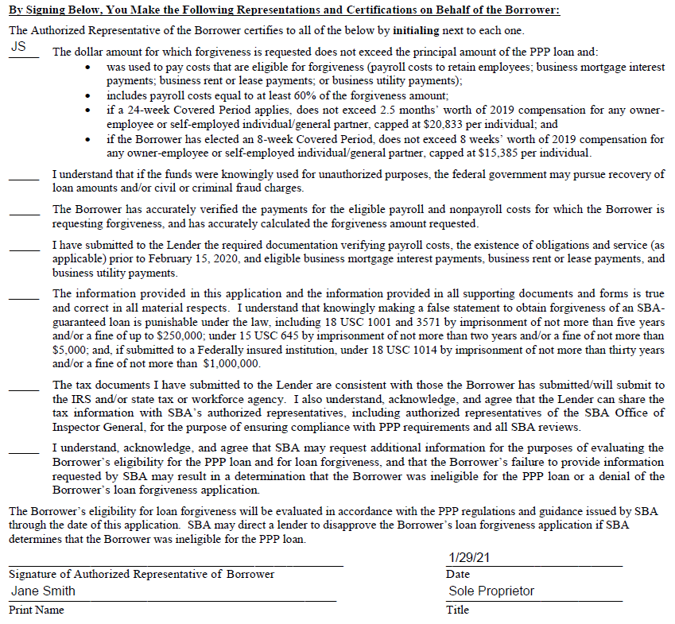
PPP Loan Forgiveness Application Form 3508S - Page 1

Slide 34
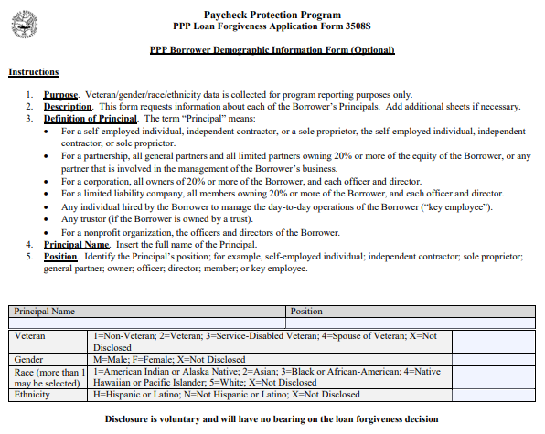
PPP Loan Forgiveness Application Form 3508S Page 2

Slide 35
Using the EZ Form vs. Regular Form
X
OR
OR

Slide 36
Example 2 – Sole Proprietorship
Using the PPP Loan Forgiveness Application Form 3508EZ
Assumptions for Smith’s Computer Services
Borrower: John Smith dba Smith’s Computer Services
Number of employees: 1 – John Smith
Pays himself a draw: $7,692.5 (once a month)
Rent Expense: $2,000 per month
Utilities Expense: $307.50 per month
Covered period: 56 days or 168 days
EZ form available at: https://www.sba.gov/document/sba-form-paycheck-protection-program-ez-loan-forgiveness-application-6-16-2020
EZ Instructions available at: https://www.sba.gov/document/sba-form--paycheck-protection-program-ez-loan-forgiveness-application-instructions-borrowers-6-16-2020

Slide 37
PPP Loan Forgiveness Application Form 3508EZ Page 1

Slide 38
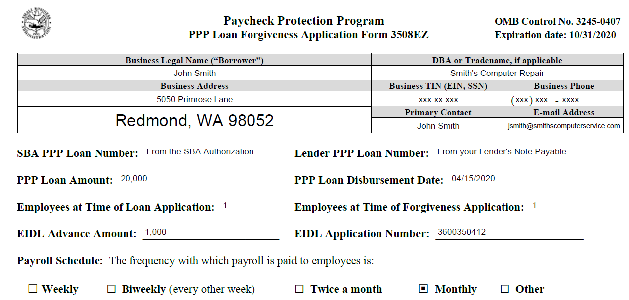
PPP Loan Forgiveness Application Form 3508EZ - Page 1
(From your EIDL Application)

Slide 39
PPP Loan Forgiveness Application Form 3508EZ - Page 1
Covered Period (56 days)
4/15/2020
6/9/2020
OR
Covered Period (168 days)
4/15/2020
9/29/2020

Slide 40
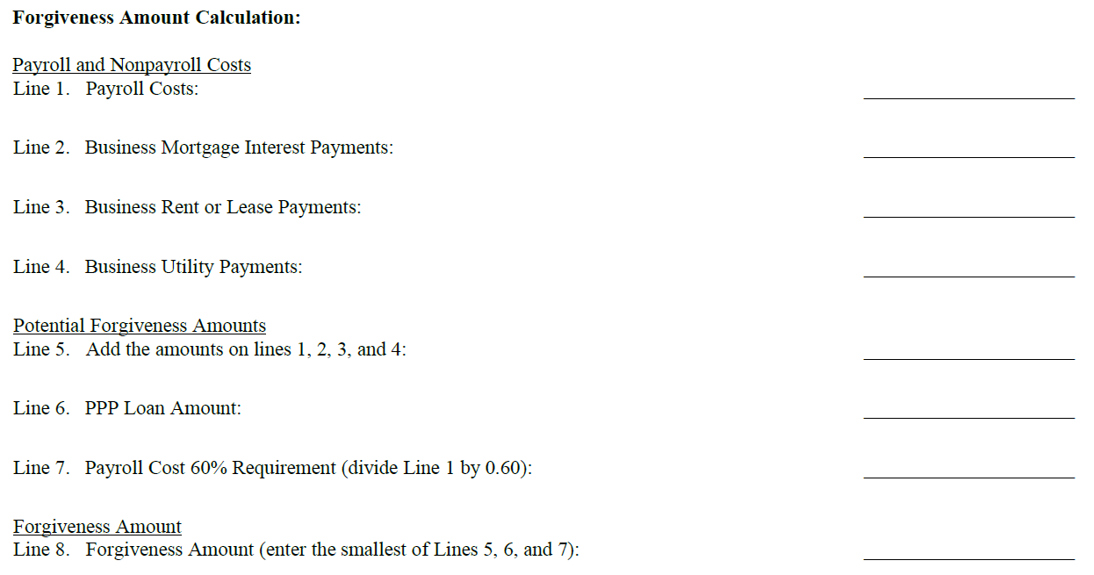
PPP Loan Forgiveness Application Form 3508EZ - Page 1
56 Days
168 Days
15,385
20,833
0
0
4,000
0
615
0
20,000
20,833
20,000
20,000
25,641
34,721
20,000
20,000

Slide 41
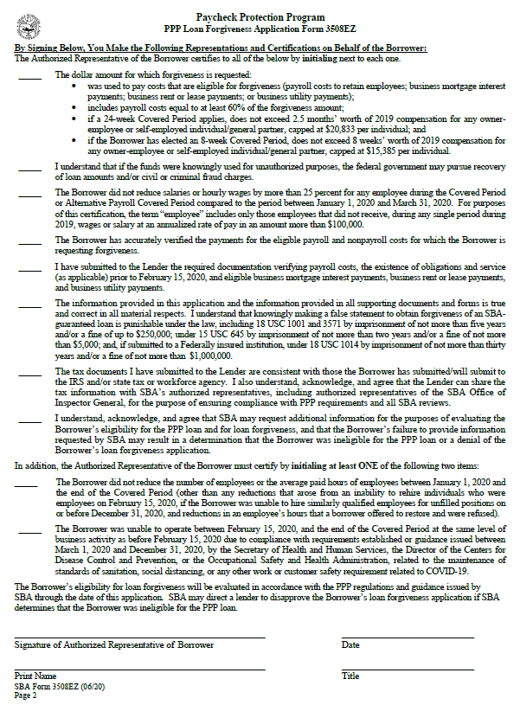
PPP Loan Forgiveness Application Form 3508EZ Page 2
JS
JS
JS
JS
JS
JS
JS
JS
OR
JS
John Smith
As soon as possible after funds are spent
John Smith
Sole Proprietor

Slide 42
PPP Loan Forgiveness Application Form 3508EZ Page 3

Slide 43
Example 3 – Corporation
Using the PPP Loan Forgiveness Application Form 3508EZ
Assumptions for Doe’s Recycling, Inc.:
Borrower: Doe’s Recycling, Inc. dba The Junk Collector
Number of employees: 20
Aggregate Payroll: $64,000 per month (payroll is bi-weekly)
Rent Expense: $10,000 per month
Utilities Expense: $1,000 per month
Covered period: 56 days or 168 days

Slide 44
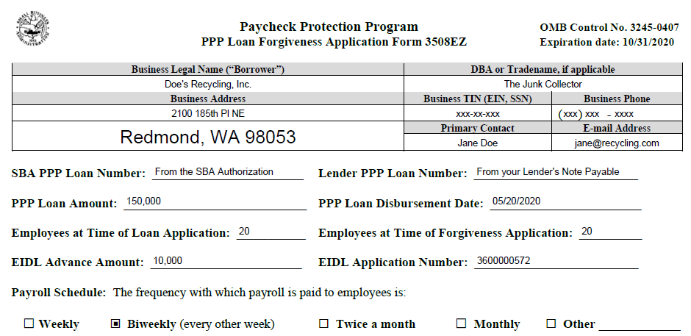
PPP Loan Forgiveness Application Form 3508EZ - Page 1
(From your EIDL Application)

Slide 45
PPP Loan Forgiveness Application Form 3508EZ - Page 1
Covered Period or Alternate Covered Period (56 days)
OR
OR
Covered Period or Alternate Covered Period (168 days)
OR

Slide 46
PPP Loan Forgiveness Application Form 3508EZ - Page 1
56 Days
168 Days
128,000
128,000
0
0
20,000
20,000
2,000
2,000
150,000
150,000
150,000
150,000
213,333
213,333
150,000
150,000

Slide 47
PPP Loan Forgiveness Application Form 3508EZ Page 2
JD
JD
JD
JD
JD
JD
JD
JD
OR
JD
Jane Doe
As soon as possible after funds are spent
Jane Doe
President

Slide 48
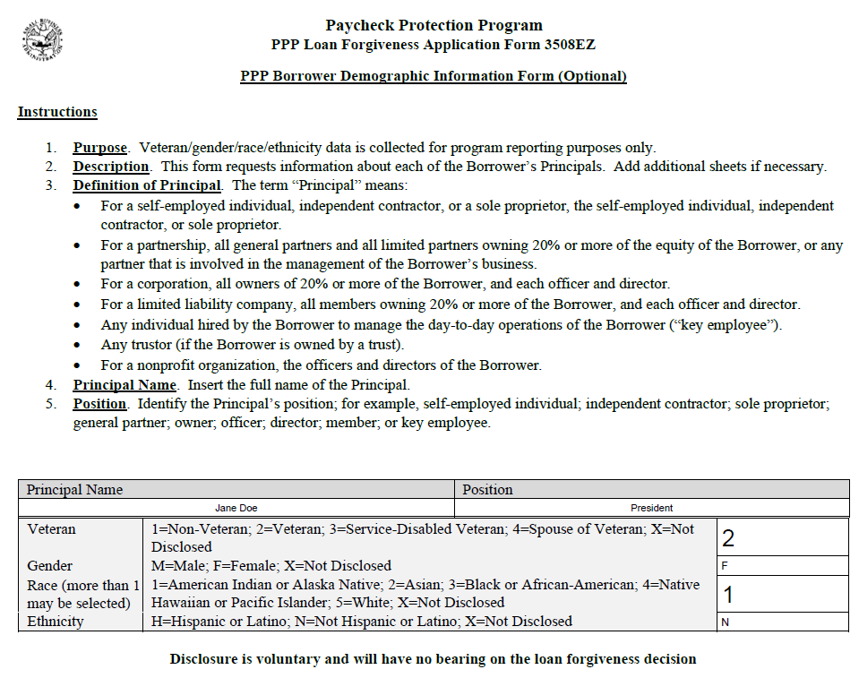
PPP Loan Forgiveness Application Form 3508EZ Page 3

Slide 49
Example 4 – LLC
Using the PPP Loan Forgiveness Application Revised June 16, 2020
Assumptions for ABC Painting, LLC.:
Borrower: ABC Painting, LLC dba All Weather Painting
Number of employees: 100
Wage Expense: $350,000 aggregate
Business Mortgage Interest Payments: $30,000 per month
Rent Expense: $15,000 per month
Utilities Expense: $1,000 per month
Covered period: 168 days
Application available at: https://www.sba.gov/document/sba-form-paycheck-protection-program-loan-forgiveness-application-revised-6-16-2020
Application instructions at: https://www.sba.gov/document/sba-form--paycheck-protection-program-loan-forgiveness-application-instructions-borrowers-6-16-2020

Slide 50
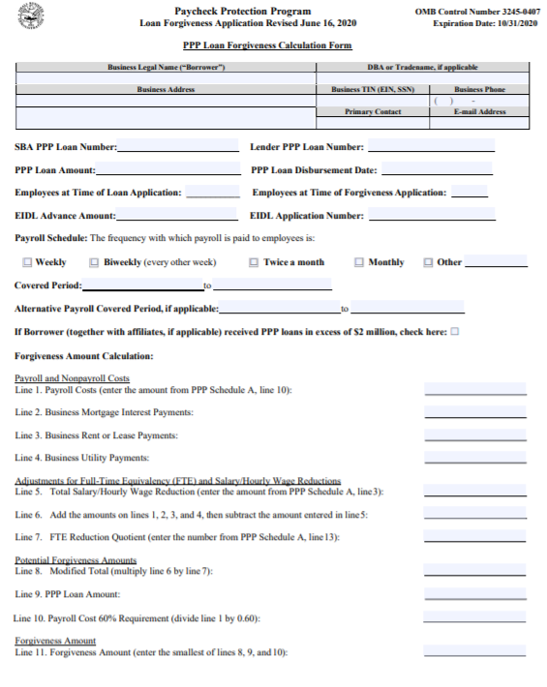
PPP Loan Forgiveness Application Form Revised June 16, 2020 Page 1

Slide 51
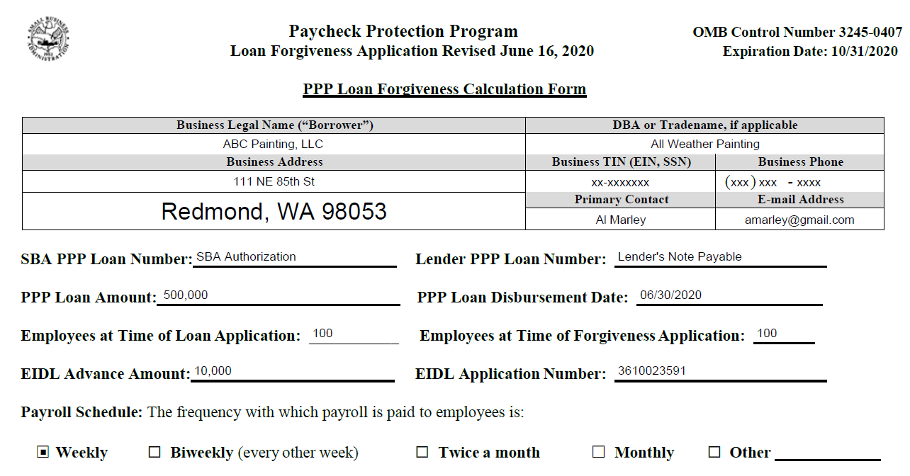
PPP Loan Forgiveness Application (revised) - Page 1
(From your EIDL Application)

Slide 52
PPP Loan Forgiveness Application (revised)- Page 1
Covered Period or Alternative Covered Period
OR

Slide 53
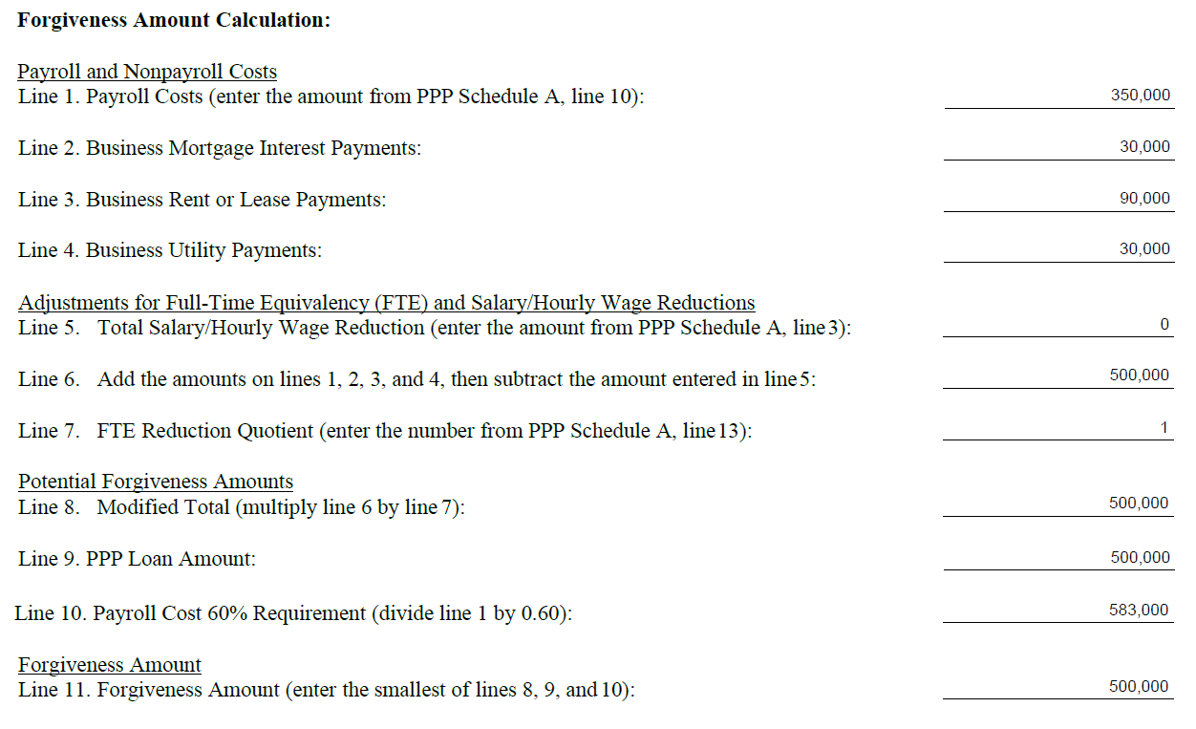
PPP Loan Forgiveness Application (revised)- Page 1
Covered Period or Alternative Covered Period
Interest Expense on a Business Asset Loan
Building and Equipment Leases

Slide 54
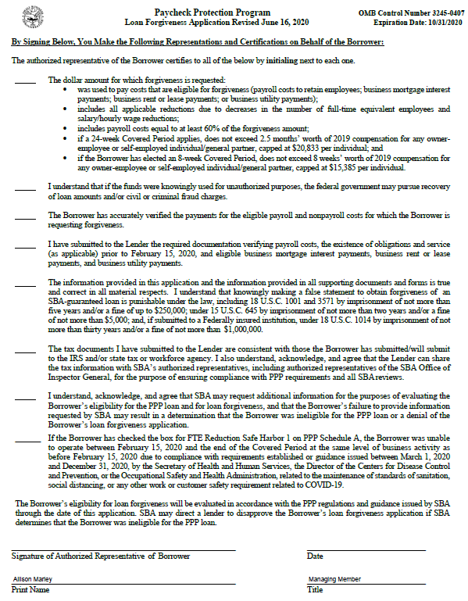
PPP Loan Forgiveness Application Form (revised) Page 2
AM
AM
AM
AM
AM
AM
AM
AM
Allison Marley
As soon as possible after funds are spent

Slide 55
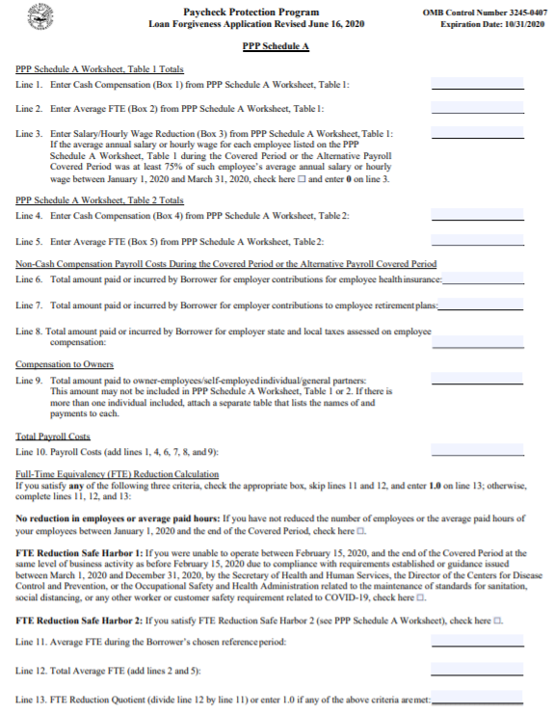
PPP Loan Forgiveness Application Form (revised) Page 3 (Schedule A)

Slide 56
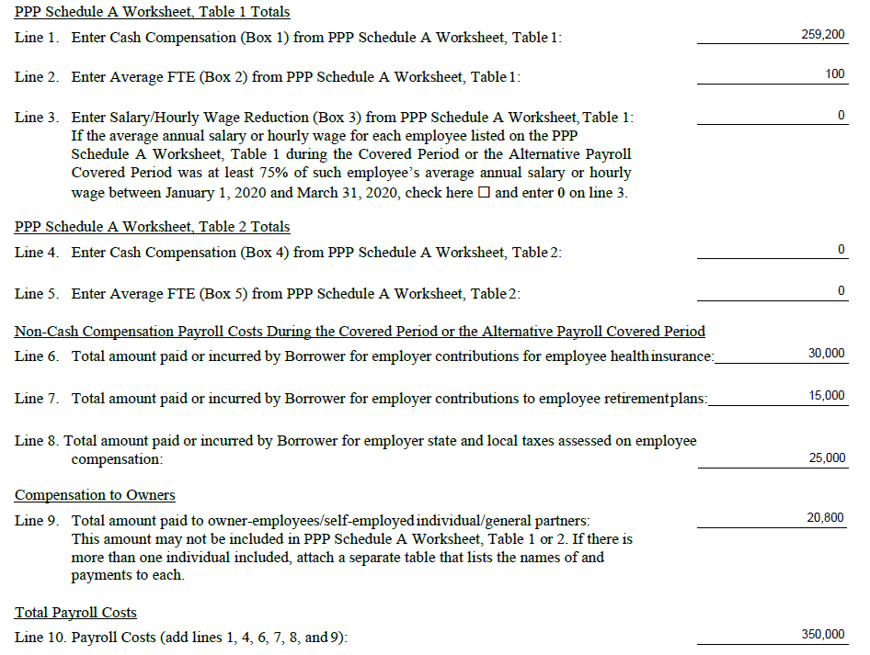
PPP Loan Forgiveness Application (revised) - Page 3
(Schedule A, Lines 1 - 10)
Interest Expense o a Business Asset Loan
Building and Equipment Leases

Slide 57
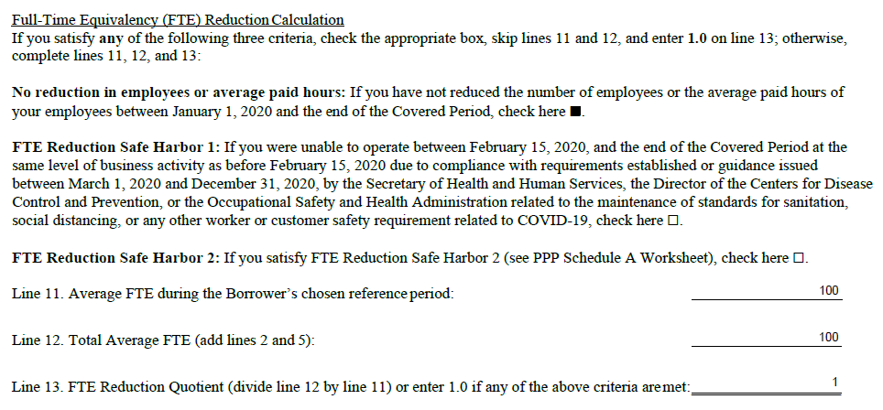
PPP Loan Forgiveness Application (revised) - Page 3
(Schedule A, Lines 11- 13)
Interest Expense o a Business Asset Loan
Building and Equipment Leases

Slide 58
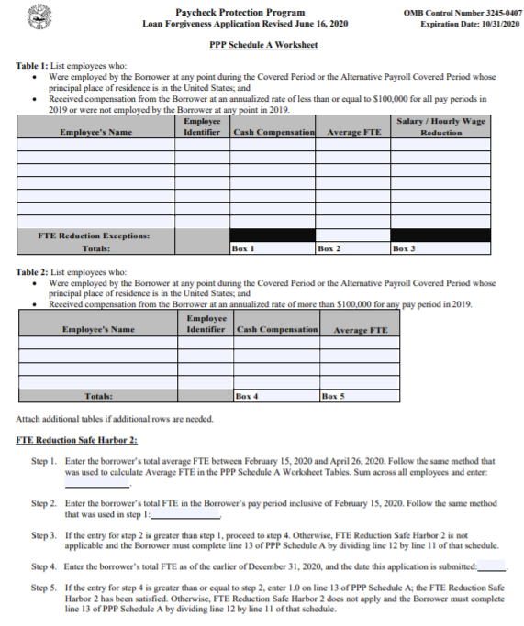
PPP Loan Forgiveness Application Form (revised) Page 4 (Schedule A Worksheet)

Slide 59
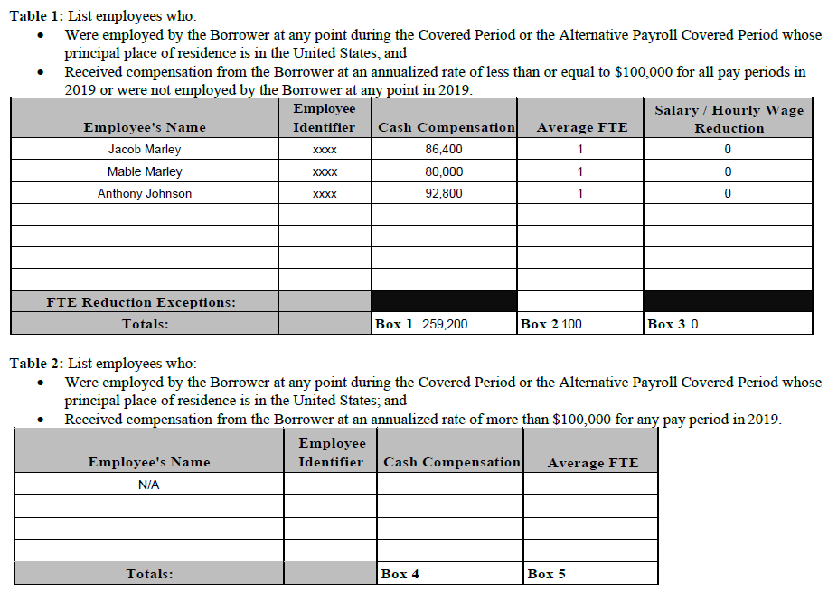
PPP Loan Forgiveness Application (revised) - Page 4
(Schedule A Worksheet, Table 1 & 2)
Add additional sheets as needed for all employees

Slide 60
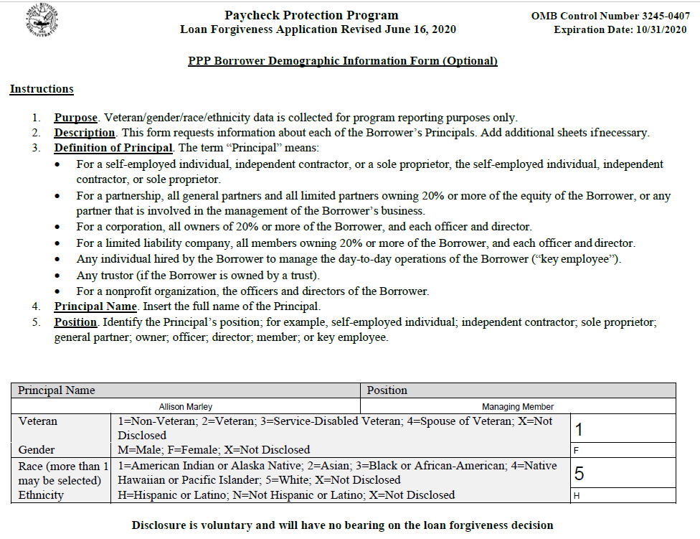
PPP Loan Forgiveness Application Form (revised) Page 5

Slide 61
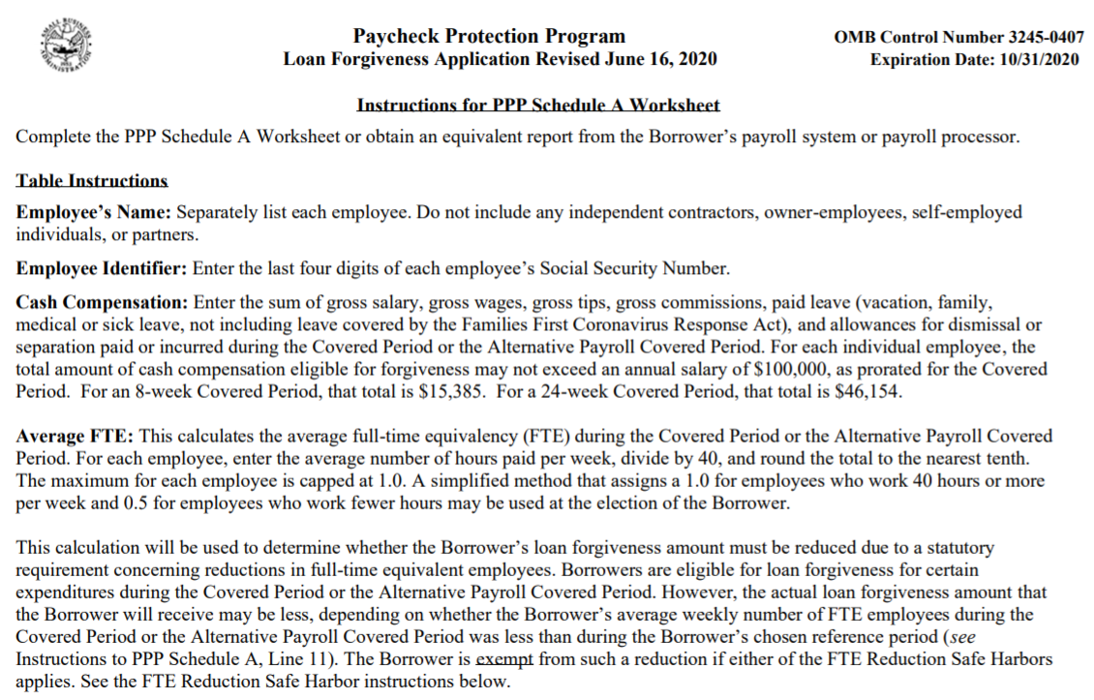
PPP Loan Forgiveness Application Form Instructions Page 4

Slide 62
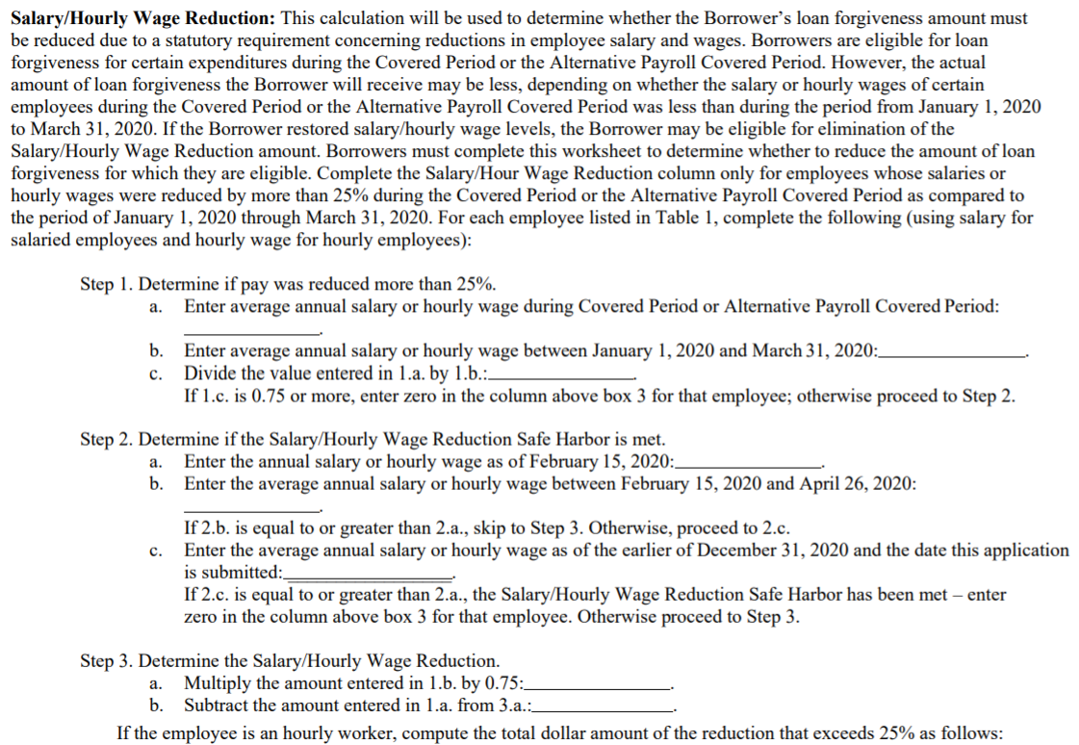
PPP Loan Forgiveness Application Form Instructions Page 4

Slide 63
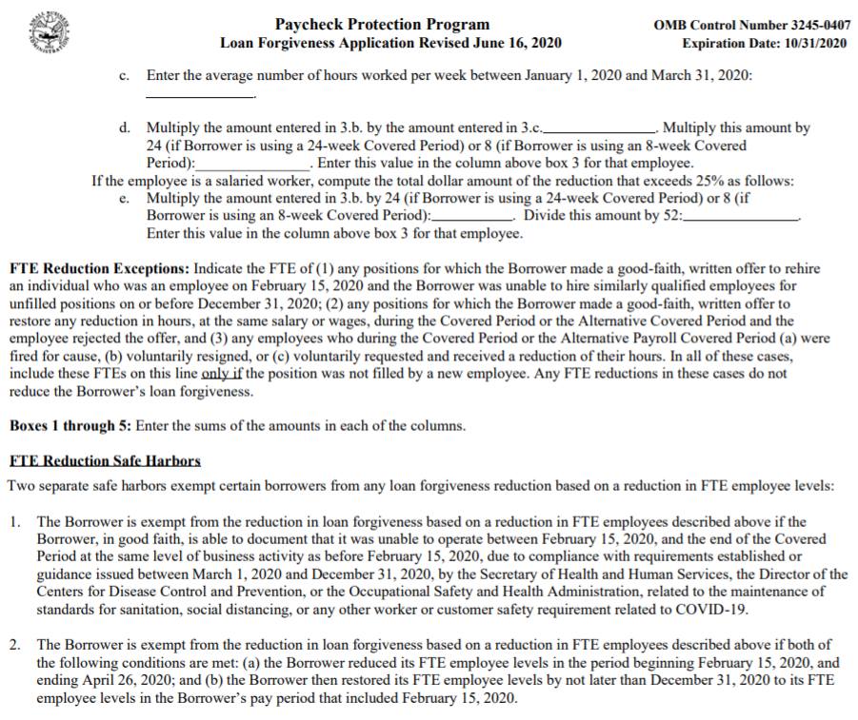
PPP Loan Forgiveness Application Form Instructions Page 5

Slide 64
Questions
U.S. Small Business Administration
Seattle District Office
206.553.7310

Slide 65
Q&A
Mark Costello
Deputy District Director
U.S. Small Business Administration
Seattle District Office
Steve Burke
Western Washington Regional Manager
Small Business Development Center
Janie Sacco
Marketing & Outreach Specialist
U.S. Small Business Administration
Seattle District Office

